Slide 1
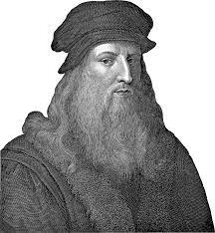
“
Simplicity is the ultimate sophistication
Leonardo Da Vinci

Slide 2


10 MIN
https://forms.gle/xSt5GLSKKxtxhppT7

Slide 3

Power Point for zero to hero !
Welcome to Power Point
Design principles
on slides
Headline
bullets
Say it
graphically !
Highlight
information
Animation
& speaker behavior
PROJECT
DAY 1
DAY 2
DAY 3
DAY 4
DAY 5
DAY 6
WEEK END

Slide 4


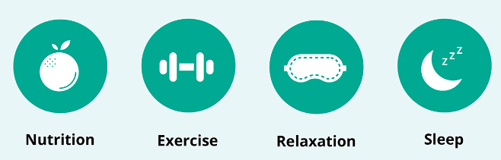
How to design effective slides ?
You don’t need to write everything
Say it
Draw it
The 4 pillars of health
The 4 pillars of health
Nutrition
Exercise
Relaxation
Sleep

Slide 5


SESSION OBJECTIVES
1 - Use image to support you ideas
2 - Migrate from bullets to easy-to-read cards
3 - Use diagrams to support you ideas

Slide 6

USE IMAGES
TO SUPPORT YOU IDEAS

Slide 7
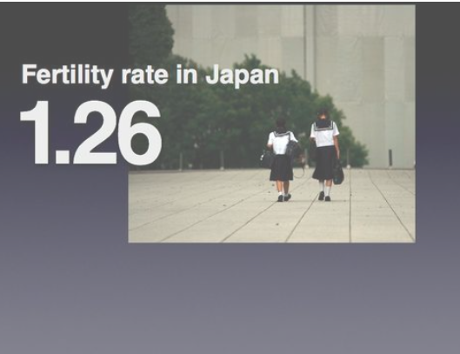


EXPLAIN
3 common mistakes on image usage
1
2
3
Image is placed randomly
Text over image
is not visible
Text and image are not related
https://www.presentationzen.com/presentationzen/visuals/
Notes:
Student can read more explanation here
https://www.presentationzen.com/presentationzen/visuals/

Slide 8

Fertility rate in Japan
1.26

Slide 9


EXPLAIN
Image rules
Only 1 image per slide
Full size
Good quality
Related to your slide message
Text is optional:
Image and text : make sure the text is contrasted
Only image : the speaker will comment the image

Slide 10

ACTIVITY
Activity
Deforestation in Cambodia
30 MIN
Create 2 slides to support the bellow speech
What do you want to write? Say? Show?
Use image and text following the rules we explained
Your speech
In 2010, Cambodia had 7.22Mha of natural forest, extending over 42% of its land area.
In 2021, it lost 141kha of natural forest, equivalent to 83.2Mt of CO₂ emissions.

